Slide 1

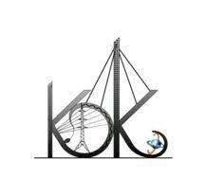

K.D.K COLLEGE OF ENGINEERING NAGPUR Department of Information Technology Seventh Semester Project Topic on:-“Virtual Assistant For Desktop” Presented by:- Sr No Name of Members Roll No 1 Ashvini Khobragade 1 2 Rupali Mamale 9 3 Pranay Lohabare 37 4 Shashank Mankar 52 Guide Name:- Prof.S.S.Ganorkar

Slide 2
CONTENT
01
02
03
04
05
06
INTRODUCTION
METHODOLOGY
FLOWCHART
WORKING PROGRESS
CONCLUSION
REFERENCES

Slide 3



INTRODUCTION
Virtual assistants (VAs) are software programs that can understand and respond to human language.
VAs are designed to automate tasks and provide information. They're becoming increasingly popular in a variety of industries.

Slide 4

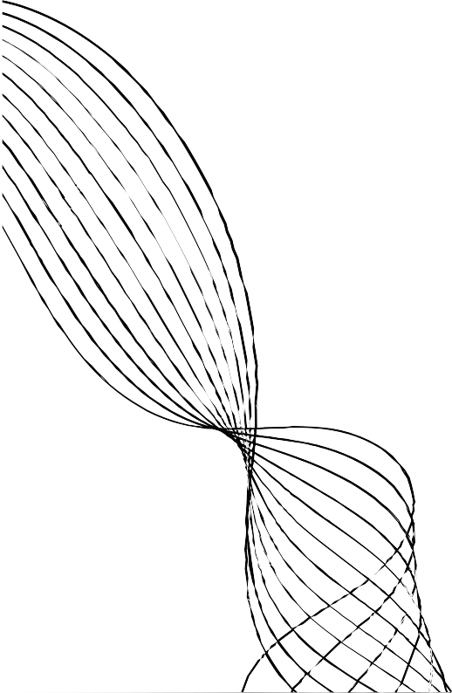
METHODOLOGY
For making virtual assistant we use some python installer packages like Speech recognition, gTTS, pipwin, etc. Speech recognition is the process of converting audio into text. This is commonly used in voice assistants like Alexa, Siri, etc.
Virtual assistants use natural language processing (NLP) to match user text or voice input to executable commands. Some continually learn using artificial intelligence techniques including machine learning and ambient intelligence. To activate a virtual.assistant using the voice, a wake word might be used.

Slide 5


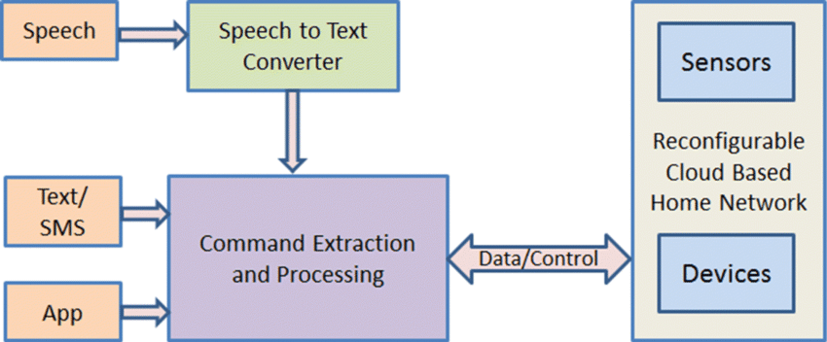
FLOWCHART
.

Slide 6

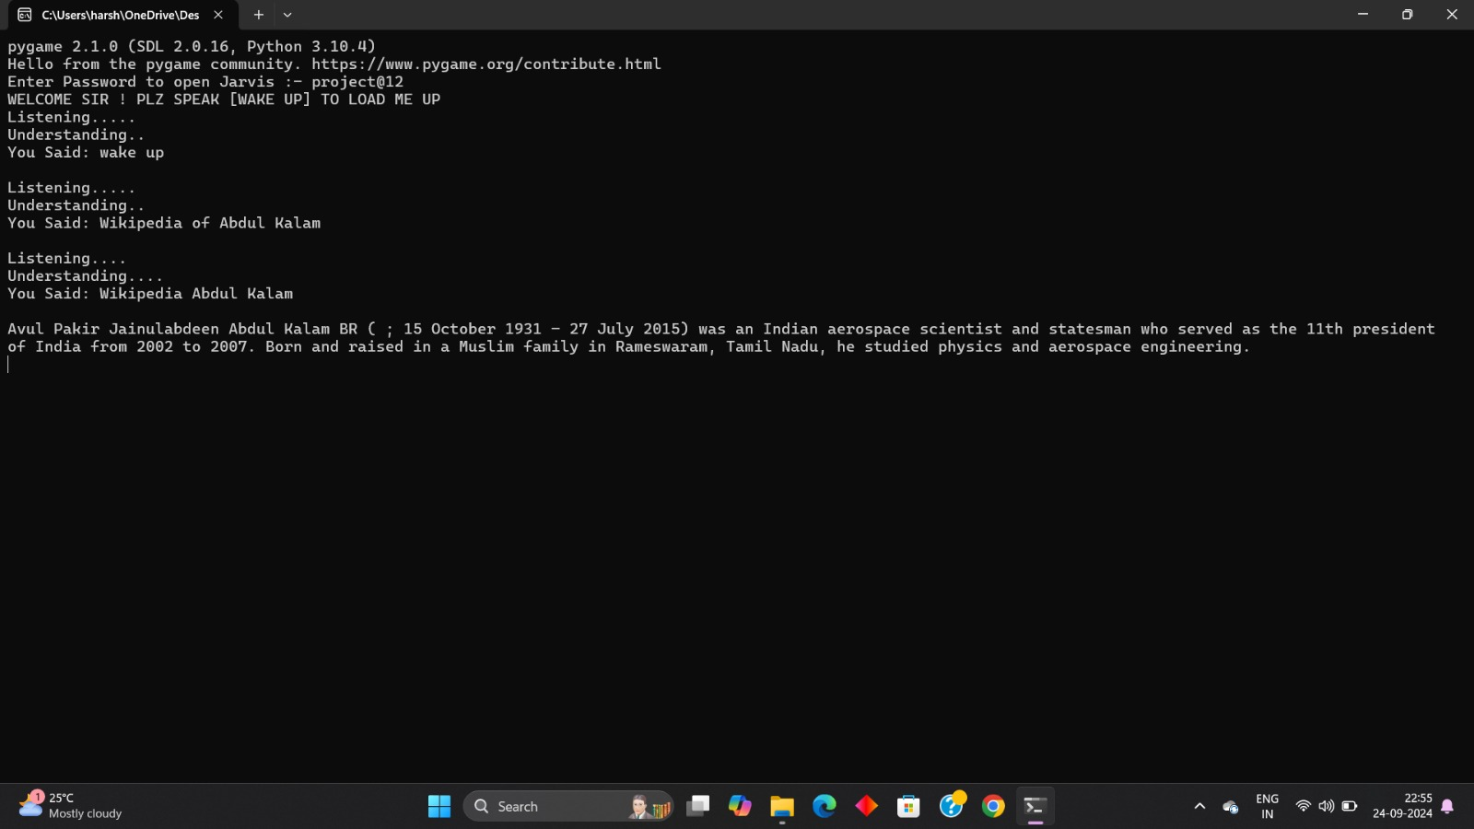
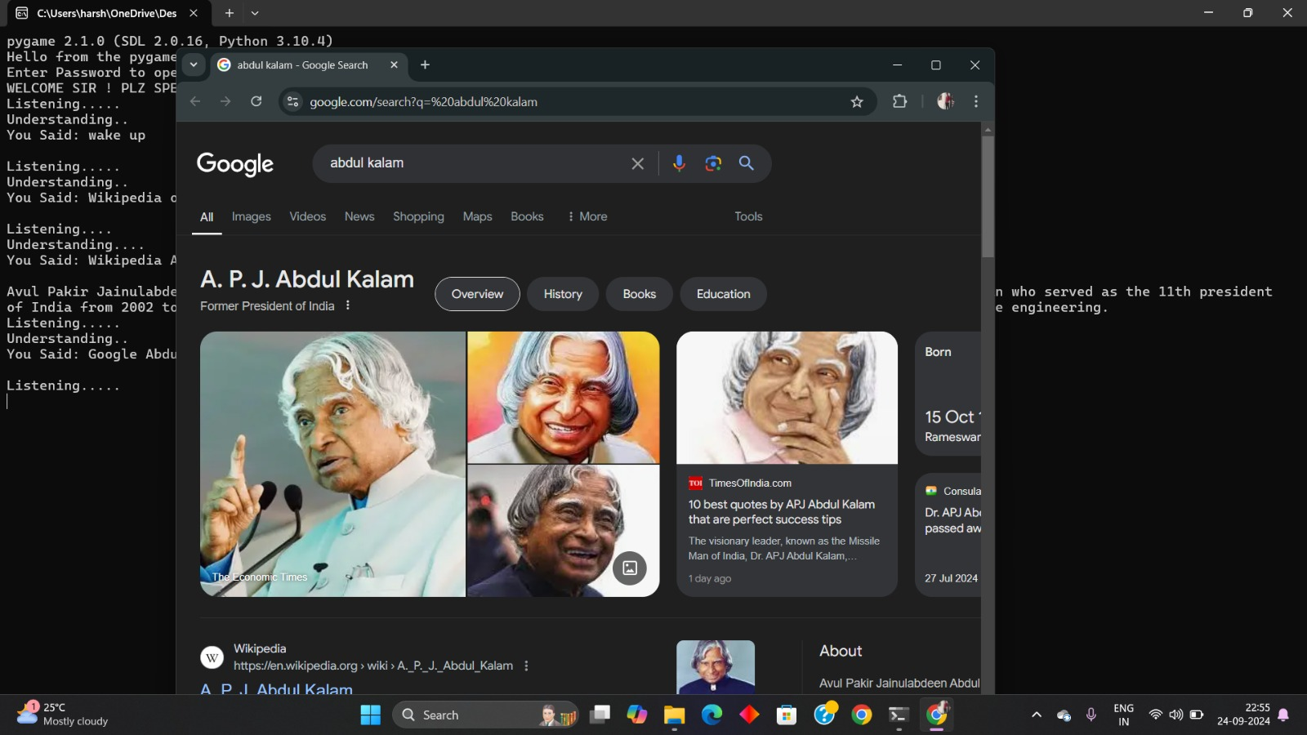
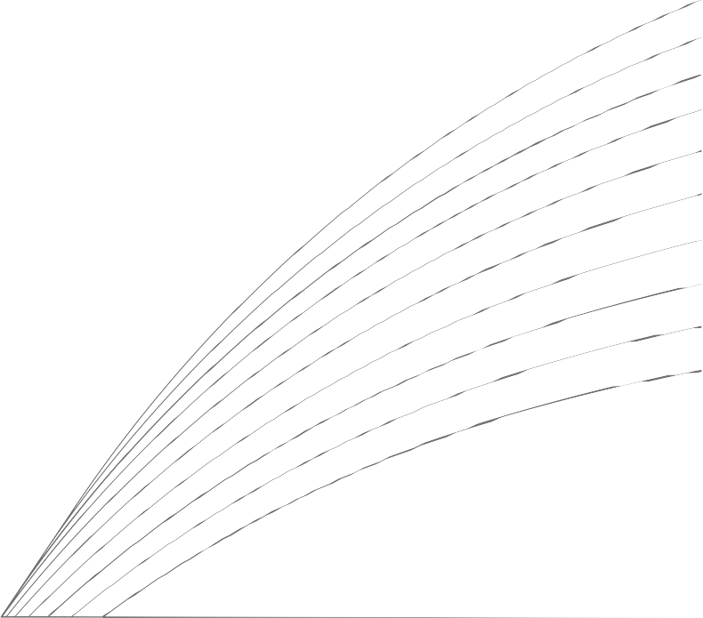
01
WORKING PROGRESS
02
03
04
.

Slide 7




CONCLUSION
Implement more sophisticated NLP techniques to improve the VA's understanding of complex language and nuances.
Utilize machine learning algorithms to enable the VA to learn from user interactions and improve its performance over time.
Enable the VA to handle multimodal inputs, such as voice, text, and images, for richer and more engaging interactions.
Integrate the VA with smart home devices to control appliances, lighting, and other home automation features.

Slide 8
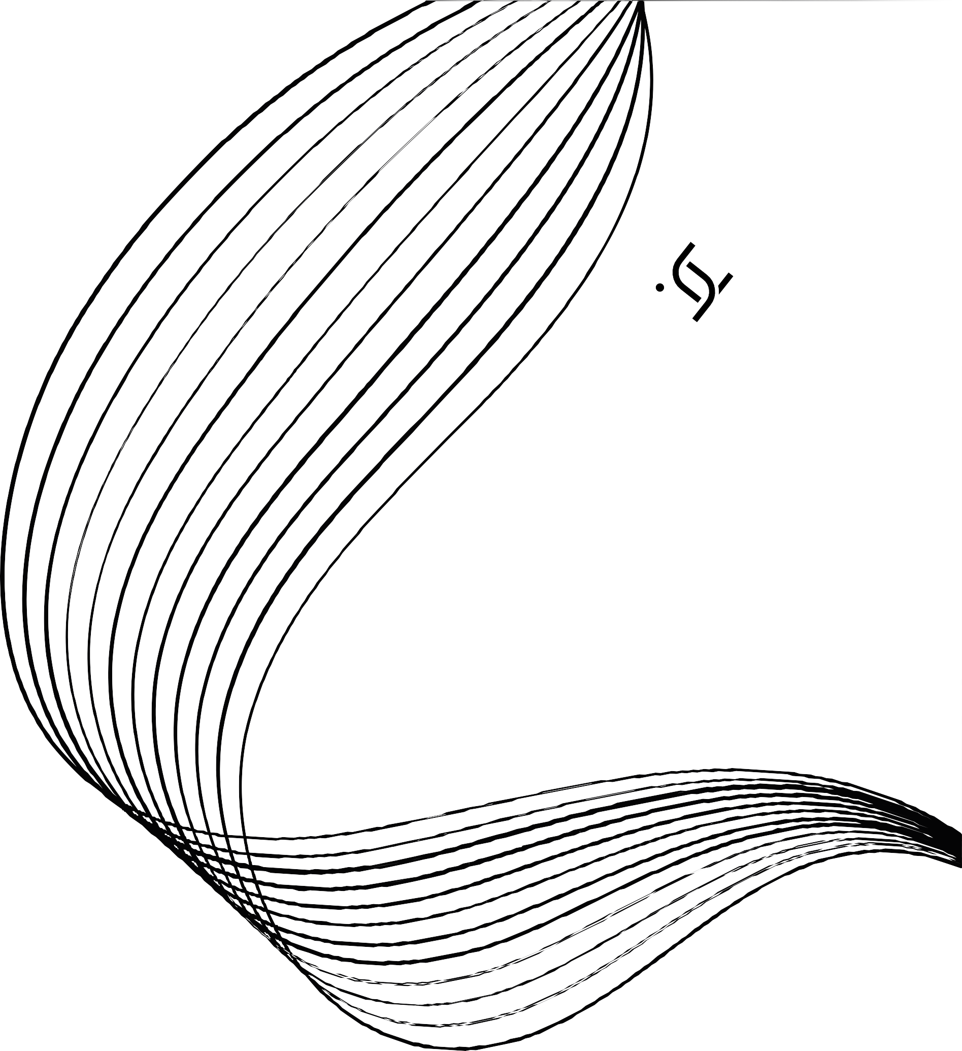
REFERENCES
[1]” Desktop Virtual Assistant” by Smita Srivastava, Dr. Devesh Katiyar, and Mr. Gaurav Goel presents a desktop virtual assistant developed in March 2022. [2]” Desktop Voice Assistant” by Vishal Kumar Dhanraj, Lokesh kriplani Semal, and Maha- jan focuses on the development of a desktop voice assistant, which was created in February 2022. [3]” Desktop Voice Assistant” by Gaurav Agrawal, Harsh Gupta, Divyanshu Jain, Chin may Jain, and Prof. Ronak Jain presents a desktop voice assistant developed in May 2020. [4]” The Technological Gap Between Virtual Assistants and Recommendation Systems” by Dimitrios Rafailidis from Maastricht University and Yannis Manolopoulos from Aris-totle University of Thessaloniki, published in January 2019. [5] ” Designing of Virtual Desktop Assistant using Machine Learning” by Vijaya Balpande, Vedanti Lute, Neha Pawar, Saniya Sadaf, and Aayush Jain describes the development of a virtual desktop assistant using machine learning techniques. The assistant is developed using Python and was created in April 2022 .

